Slide 1




Diseases in vineyards and biological methods of prevention
Association Prosperity and Development in Bulgaria Project:“SOS for endangered traditional vine varieties” Acronym: “VineSOS”
Project No. 1829
2700 Blagoevgrad
“Stefan Stambolov” str. №1, fl. 2
tel. +359 896 04 09 03 /+ 359 876 71 24 09
e-mail: pdbulgaria2010@gmail.com

Slide 2
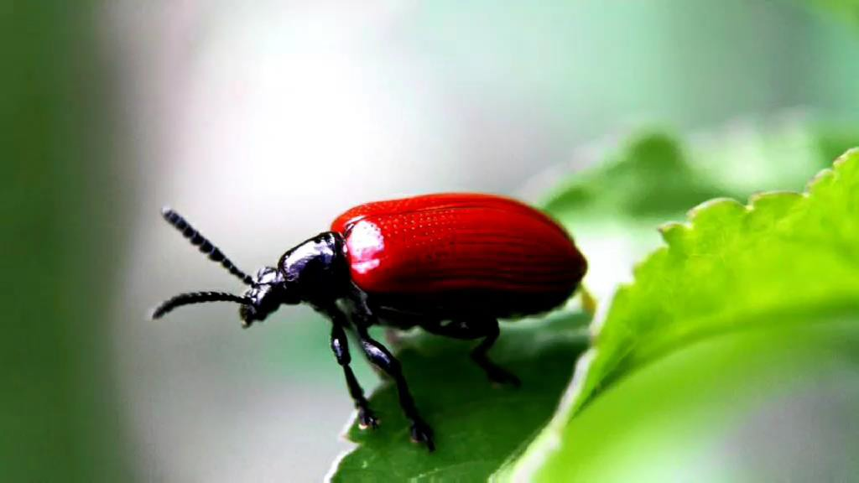

Diseases in vineyards
This knowledge will be useful to you if :
You are having difficulty growing vines in terms of determining the symptoms and morbidity of the vines.
You want to grow vineyards.
You have difficulty fighting diseases in the vines and want a biological approach to treatment.
We shall consider:
The main diseases that affect the vines
How to recognize the most common diseases in vines
The main symptoms of vine diseases
Association Prosperity and Development in Bulgaria Project:“SOS for endangered traditional vine varieties” Acronym: “VineSOS”
Project No. 1829
2700 Blagoevgrad
“Stefan Stambolov” str. №1, fl. 2
tel. +359 896 04 09 03 /+ 359 876 71 24 09
e-mail: pdbulgaria2010@gmail.com

Slide 3


Leaf diagnostics
It is based on the results of leaf analysis to determine the need of the vines for a given nutrient. The data obtained from the analysis of the leaves are compared with the critical level of the respective nutrient.
The most accurate results are obtained through the combined use of soil analysis, leaf diagnostics, vine growth and yield.
Association Prosperity and Development in Bulgaria Project:“SOS for endangered traditional vine varieties” Acronym: “VineSOS”
Project No. 1829
2700 Blagoevgrad
“Stefan Stambolov” str. №1, fl. 2
tel. +359 896 04 09 03 /+ 359 876 71 24 09
e-mail: pdbulgaria2010@gmail.com

Slide 4


Diseases in vineyards
Nitrogen deficiency
Starvation is a deficiency of some micronutrients that cause anxiety. The most efficient solution is foliar fertilization. One of the main forms of starvation is shown in the photo on the right.
This vine is deficient in nitrogen, chlorosis appears in the form of a very light yellow color, the leaves lighten to transparent.
The reason may be the quality of the air background. Prevention: Ferrous sulphate solution. For treatment, dissolve 50 g in 10 liters of water and spray every 4-5 days until the green color of the leaves is restored. For prevention 10 g of ferrous sulphate are dissolved in 10 liters of water.
Association Prosperity and Development in Bulgaria Project:“SOS for endangered traditional vine varieties” Acronym: “VineSOS”
Project No. 1829
2700 Blagoevgrad
“Stefan Stambolov” str. №1, fl. 2 tel. +359 896 04 09 03 /+ 359 876 71 24 09
e-mail: pdbulgaria2010@gmail.com

Slide 5
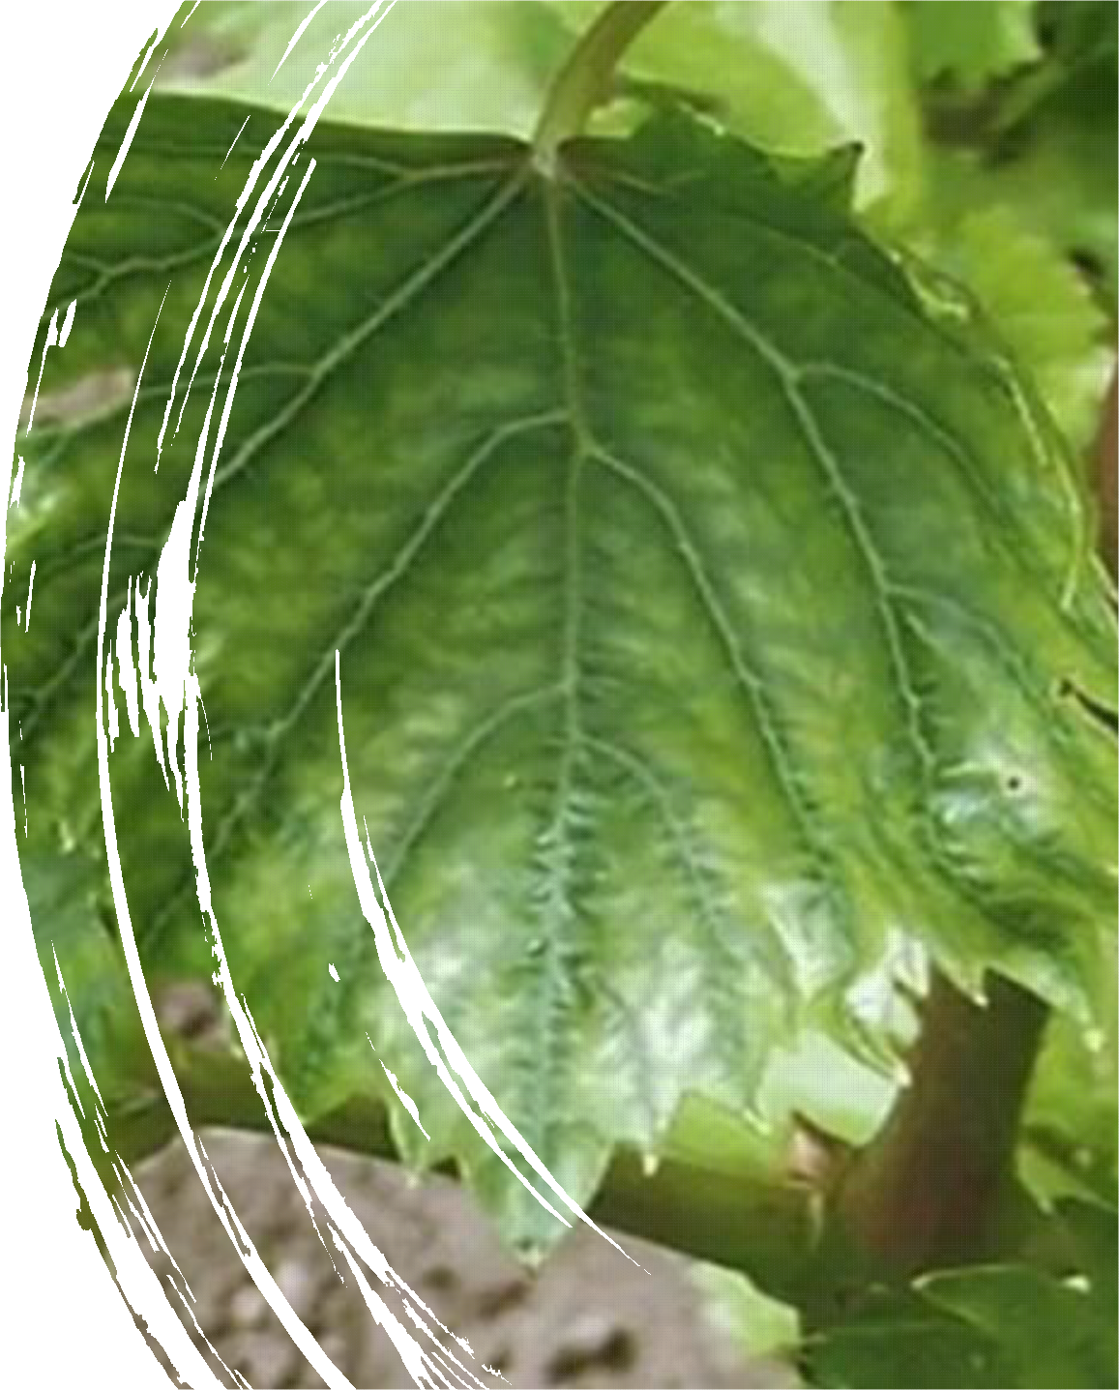
Diseases in vineyards
Zinc deficiency
Zinc deficiency can be recognized by immature shoots with small and deformed leaves, visible in early summer, when the secondary growth of shoots is.
The leaves are covered with yellow chlorotic spots, the veins of the leaves and the adjacent tissue remain green. The clusters become loose, the berries remain smaller, single larger berries appear and most of them have no seeds. Zinc increases the content of soluble salts in the fruit and reduces the acidity of grape juice.
Prevention and treatment: Zinc acetate dihydrate 99% /zinc chelate, organic zinc/. It is applied as an 8% aqueous solution for fertilizing the leaf mass and a 98% solution for application in the soil. An entirely biological variant is Liquid Nettle Fertilizer.
2700 Blagoevgrad
“Stefan Stambolov” str. №1, fl. 2 tel. +359 896 04 09 03 /+ 359 876 71 24 09
e-mail: pdbulgaria2010@gmail.com

Slide 6
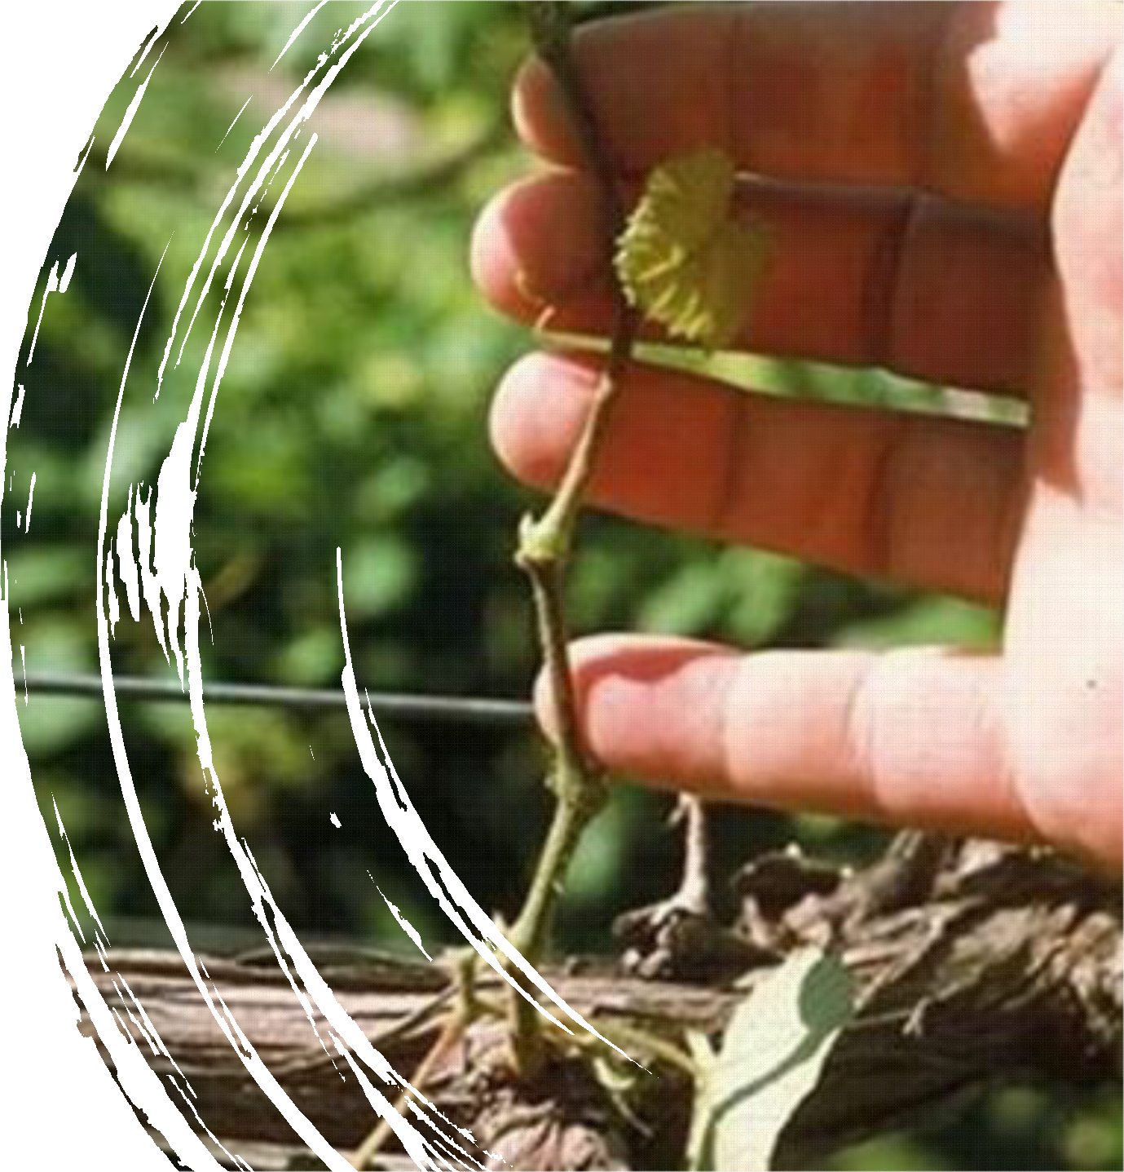
Diseases in vineyards
Boron deficiency
а.
Boron is a trace element that is involved in many enzymatic processes in all stages of grapevine. Affects reproductive activity. In the absence of Boron, the leaves of the vine become discolored and pale areas appear between the threads. Browning is often an indicator, and the shoots bend outwards, the roots weaken, which leads to frost in winter.
Prevention: Biological solution is an aqueous solution with pine oil 1g: 10 kg water.
2700 Blagoevgrad
“Stefan Stambolov” str. №1, fl. 2 tel. +359 896 04 09 03 /+ 359 876 71 24 09
e-mail: pdbulgaria2010@gmail.com

Slide 7
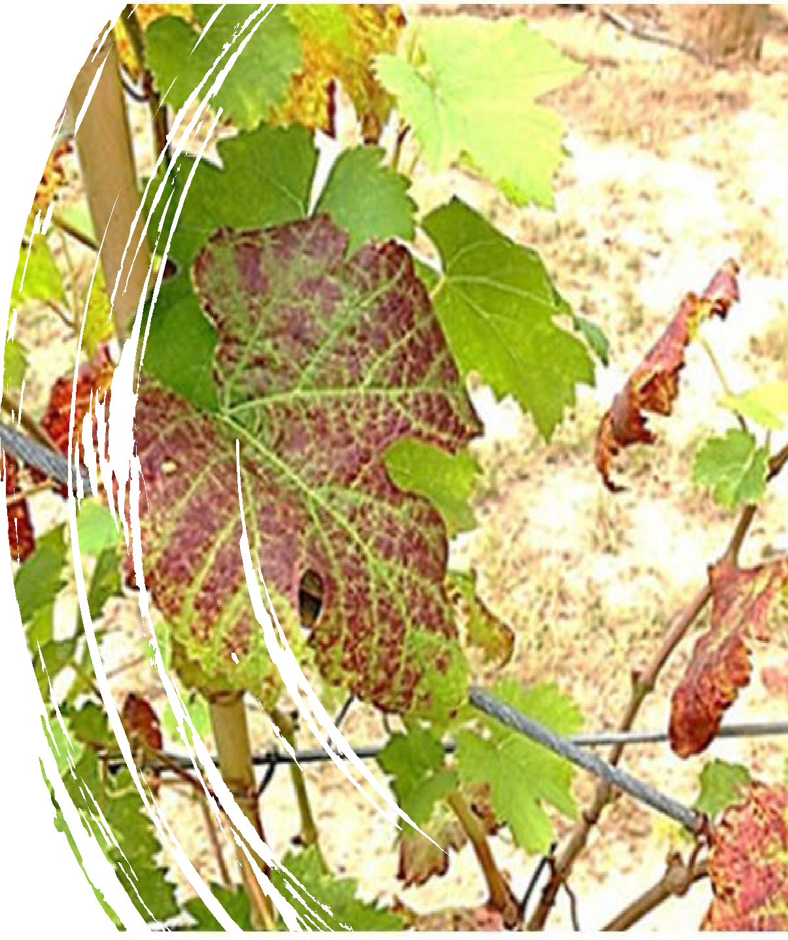
Diseases in vineyards
Potassium deficiency
Potassium is especially important in the cultivation of wine varieties. It is involved in the active transport of sugars from the leaf mass to the fruit. At high levels of Nitrogen and low levels of Potassium the vine becomes susceptible to leaf pests. With potassium deficiency, there is chlorosis, yellowing from the edges to the middle of the leaves and a smaller number of shoots, slow and reduced growth.
Lower yield.
2700 Blagoevgrad
“Stefan Stambolov” str. №1, fl. 2 tel. +359 896 04 09 03 /+ 359 876 71 24 09
e-mail: pdbulgaria2010@gmail.com

Slide 8
Diseases in vineyards
Calcium deficiency
Calcium is very important for the yield of grapes and is critical for some quality indicators such as berry skin strength, disease resistance, reducing grape rot. Calcium deficiency leads to loss of clusters and berries. Almost 40% of calcium goes into the leaves and for the growth of vine sticks. Calcium is a key element of cell walls, managing the membrane structure and regulation of enzyme systems, the activity of phytohormones and the absorption of nutrients. The element affects the quality of the fruit, color and aroma. In case of calcium deficiency, the vines are very sensitive to low temperatures. Vineyards with magnesium and calcium deficiency are more sensitive to necrotization of cluster rachis. In most cases, calcium deficiency has no visible symptoms on the leaves of the vines, in case they are visible, the leaves are smaller with small necrotic spots. With severe calcium deficiency, root branches and shoots die.
2700 Blagoevgrad
“Stefan Stambolov” str. №1, fl. 2 tel. +359 896 04 09 03 /+ 359 876 71 24 09
e-mail: pdbulgaria2010@gmail.com

Slide 9
Diseases in vineyards
Calcium deficiency
The effect of the element on the formation of cracks on the surface of the grape.
A research of Hunan Agricultural University, Changsha, China Fruit cracking is the result of a physiological imbalance in many plant species, and leads to severe economic losses. The aim of this study was to investigate the effect of calcium on fruit cracking and to outline the main mechanisms. The study was performed on the effect of exogenous calcium on grape berry cracking, calcium absorption and distribution and cell wall metabolism in the cracking variety 'Xiangfei“. Calcium significantly reduces the frequency of fruit cracking, increases the breaking strength of the berry skin and stimulates calcium storage.
In addition, the element increases the content of protopectin and inhibits the increase in the content of water-soluble pectin by regulating the transcription and enzyme activities associated with cell wall metabolism. Taken together, the results show that dipping grape seeds in a calcium solution is effective in preventing fruit cracking by stimulating calcium absorption, inhibiting cell wall disintegration and promoting its strengthening.
2700 Blagoevgrad
“Stefan Stambolov” str. №1, fl. 2 tel. +359 896 04 09 03 /+ 359 876 71 24 09
e-mail: pdbulgaria2010@gmail.com

Slide 10
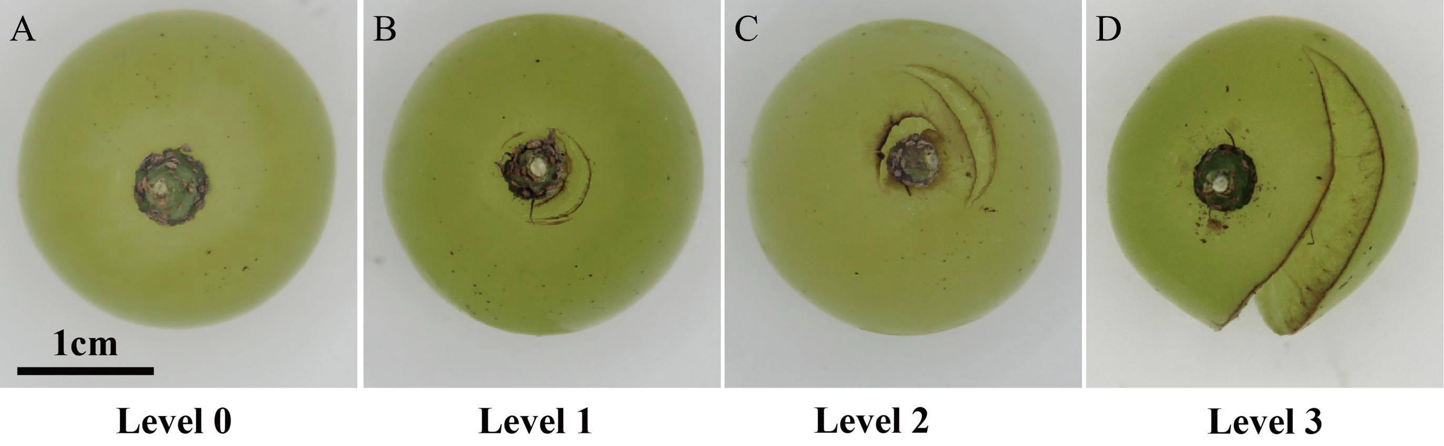
Diseases in vineyards
Calcium deficiency. Stages
Figure 1: Fruit-cracking levels of grape berries based on severity.
(A) Fruit-cracking level 0. (B) Fruit-cracking level 1. (C) Fruit-cracking level 2.
Association Prosperity and Development in Bulgaria
2700 Blagoevgrad
Project:“SOS for endangered traditional vine varieties”
Acronym: “VineSOS”
Project No. 1829
(D) Fruit-crcacking level 3.
“Stefan Stambolov” str. №1, fl. 2 tel. +359 896 04 09 03 /+ 359 876 71 24 09
e-mail: pdbulgaria2010@gmail.com

Slide 11
Diseases in vineyards
Calcium deficiency
Fruit cracking is a physiological process in which cracks appear in the fruit exocarp and mesocarp. This disorder affects the appearance of the fruit, increases water loss, susceptibility to pathogenic infection and reduces the storage life of grapes, thus leading to significant commercial losses for producers. Fruit cracking is influenced by external factors, including agronomic:
irrigation, pruning, rootstock selection and fertilization and environmental factors:
rainfalls, temperature, high humidity and fruit characteristics, such as shape, fruit size, sugar content, anatomy and mechanical properties of the skin.
To prevent localized calcium deficiency and to promote improved grape quality, it is necessary to supply calcium during the ripening stage.
In studying the effect of exogenous calcium on grape berry cracking, Hunan Agricultural University analyzed the mechanical properties of the skin, the absorption and distribution of calcium and cell wall metabolism.
Association Prosperity and Development in Bulgaria 2700 Blagoevgrad
Project:“SOS for endangered traditional vine varieties”
Acronym: “VineSOS”
Project No. 1829
“Stefan Stambolov” str. №1, fl. 2 tel. +359 896 04 09 03 /+ 359 876 71 24 09
e-mail: pdbulgaria2010@gmail.com

Slide 12
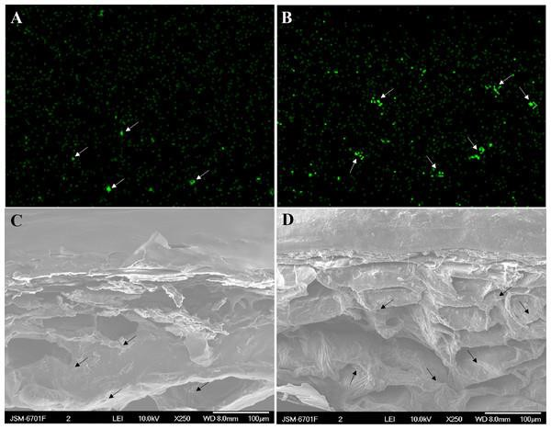
Diseases in vineyards
2700 Blagoevgrad
“Stefan Stambolov” str. №1, fl. 2 tel. +359 896 04 09 03 /+ 359 876 71 24 09
e-mail: pdbulgaria2010@gmail.com
Calcium deficiency
Figure 2: Cross-sectional element mapping and corresponding scanning electron micrograph of the skin of grape ‘Xiangfei’ berries at 47 days after full bloom.
Green fluorescence indicates calcium-rich zones. The corresponding calcium-rich zone in the cellular image is indicated by arrows. Control: (A) and (C); Calcium: (B) and (D).
Association Prosperity and Development in Bulgaria
Project:“SOS for endangered traditional vine varieties”
Acronym: “VineSOS”
Project No. 1829

Slide 13
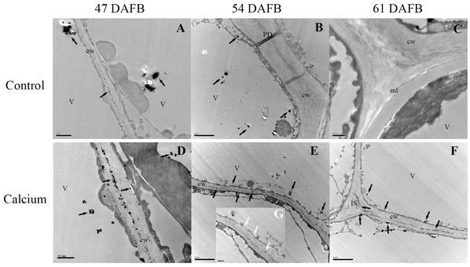
Diseases in vineyards
Calcium deficiency
Figure 3: Cellular distribution of calcium in cell wall of epidermal and hypodermal cells.
Control at 47 DAFB (A), 54 DAFB (B)and 61 DAFB (C); Calcium treatment at 47 DAFB (D), 54 DAFB (E)and 61 DAFB (F). Black
arrows indicate Ca grains. White arrows indicate the Ca grains washed by EGTA. cw, cell wall; V, vacuole; IS, intercellular space; PD, plasmodesmata; ml, middle lamella.
2700 Blagoevgrad
“Stefan Stambolov” str. №1, fl. 2 tel. +359 896 04 09 03 /+ 359 876 71 24 09
e-mail: pdbulgaria2010@gmail.com

Slide 14
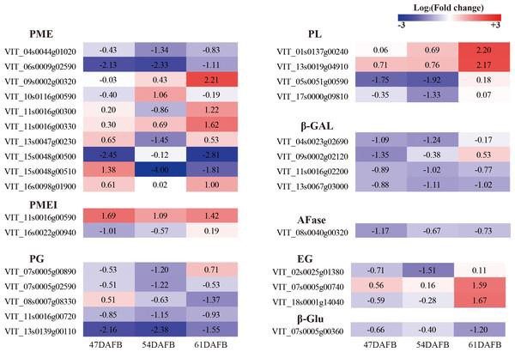
Diseases in vineyards
Calcium deficiency
Figure 4: Heat map of log₂ (Fold change) of the DEGs involved in cell wall metabolism.
To complete the study, the genes that are affected by calcium starvation were identified.
The result of the analysis showed that the Log field was the gene PL_VIT 01s0137.
2700 Blagoevgrad
“Stefan Stambolov” str. №1, fl. 2 tel. +359 896 04 09 03 /+ 359 876 71 24 09
e-mail: pdbulgaria2010@gmail.com

Slide 15
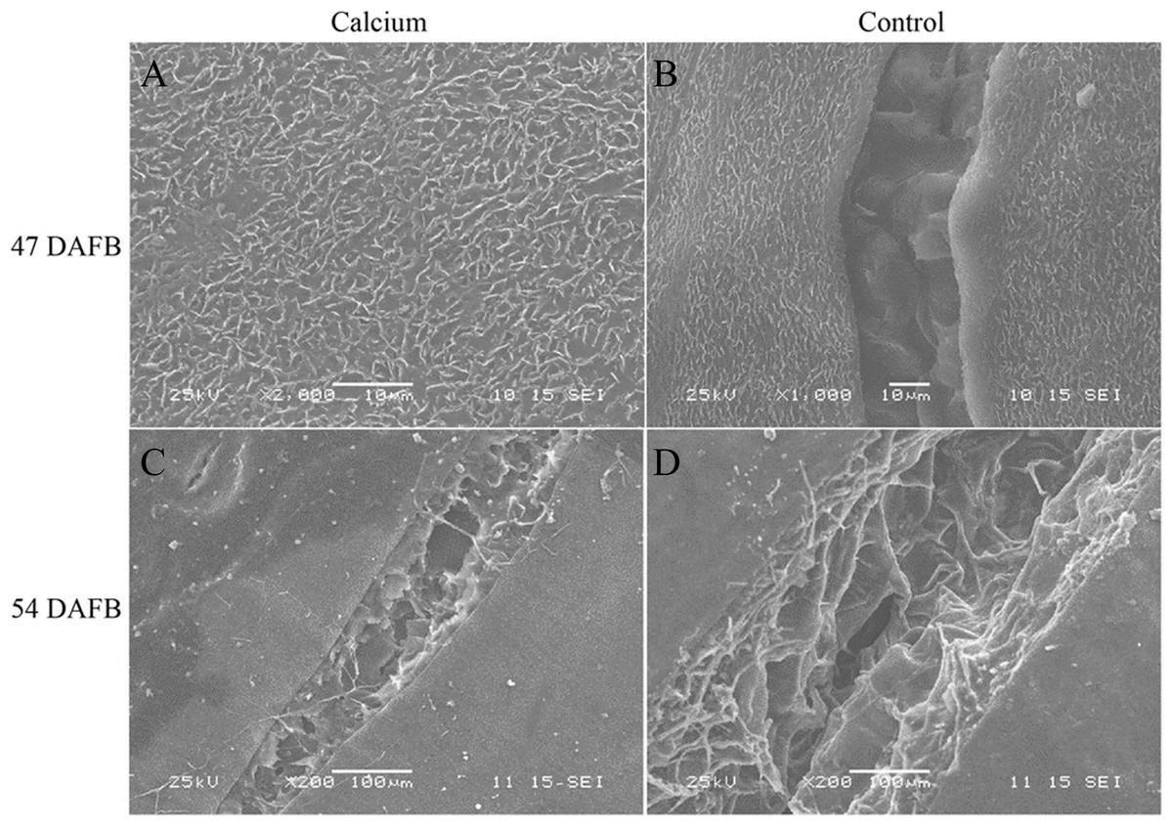
Diseases in vineyards
Calcium deficiency
Figure 5: Micrographs of fruit surface observed by scanning electron microscopy.
(A) Fruit surface of calcium treament at 47 DAFB. (B) Fruit surface in control at 47 DAFB. (C) Fruit surface of calcium treament at 54 DAFB. (D) Fruit surface in control at 54 DAFB.
2700 Blagoevgrad
“Stefan Stambolov” str. №1, fl. 2 tel. +359 896 04 09 03 /+ 359 876 71 24 09
e-mail: pdbulgaria2010@gmail.com

Slide 16
Diseases in vineyards
Calcium deficiency
Results shown by grape berries when treated with calcium
 |  |  |  | Calcium |  |  | Control
 | Longitudinal diameter (mm) |  |  | 23.29 ± 1.10a |  |  | 22.15 ± 0.63a
 | Transverse diameter (mm) |  |  | 21.85 ± 0.71a |  |  | 21.72 ± 0.59a
 | Total soluble solid (%) |  |  | 16.38 ± 0.11a |  |  | 15.91 ± 0.29a
 | Titratable acidity (%) |  |  | 0.29 ± 0.02a |  |  | 0.36 ± 0.04a
 | Water content (%) |  |  | 83.16 ± 0.59a |  |  | 82.27 ± 0.26a
After treatment with calcium, the results are undeniable. Control grape berries show concentric fine cracks that are confined to the skins and epidermal cells and are developed on the basis of the pedicel on the grainy skin in the control, while most fruits in calcium treatment are without concentric fine cracks.
2700 Blagoevgrad
“Stefan Stambolov” str. №1, fl. 2 tel. +359 896 04 09 03 /+ 359 876 71 24 09
e-mail: pdbulgaria2010@gmail.com

Slide 17
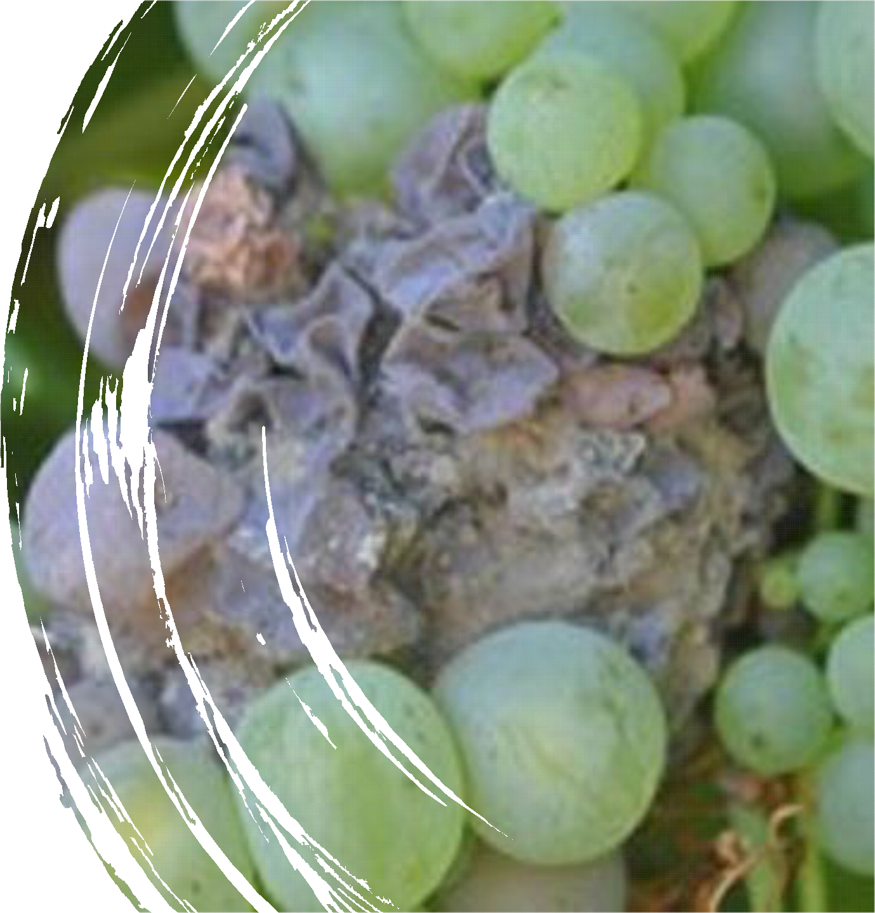
,
о
Diseases in vineyards
Gray rot
With the appearance of gray rot on the vine, the formation of watery spots is observed on the surface of the skin of the berries, which grow, merge and cover the whole berries. The skin cracks and separates easily from the flesh. In dry weather the infested berries wrinkle and dry out and in wet weather they rot and become covered with abundant spore-bearing coating.
Prevention and treatment: sulfur-lime solution, colloidal sulfur every 8-14 days, prophylactic decoction of horsetail.
2700 Blagoevgrad
“Stefan Stambolov” str. №1, fl. 2 tel. +359 896 04 09 03 /+ 359 876 71 24 09
e-mail: pdbulgaria2010@gmail.com

Slide 18
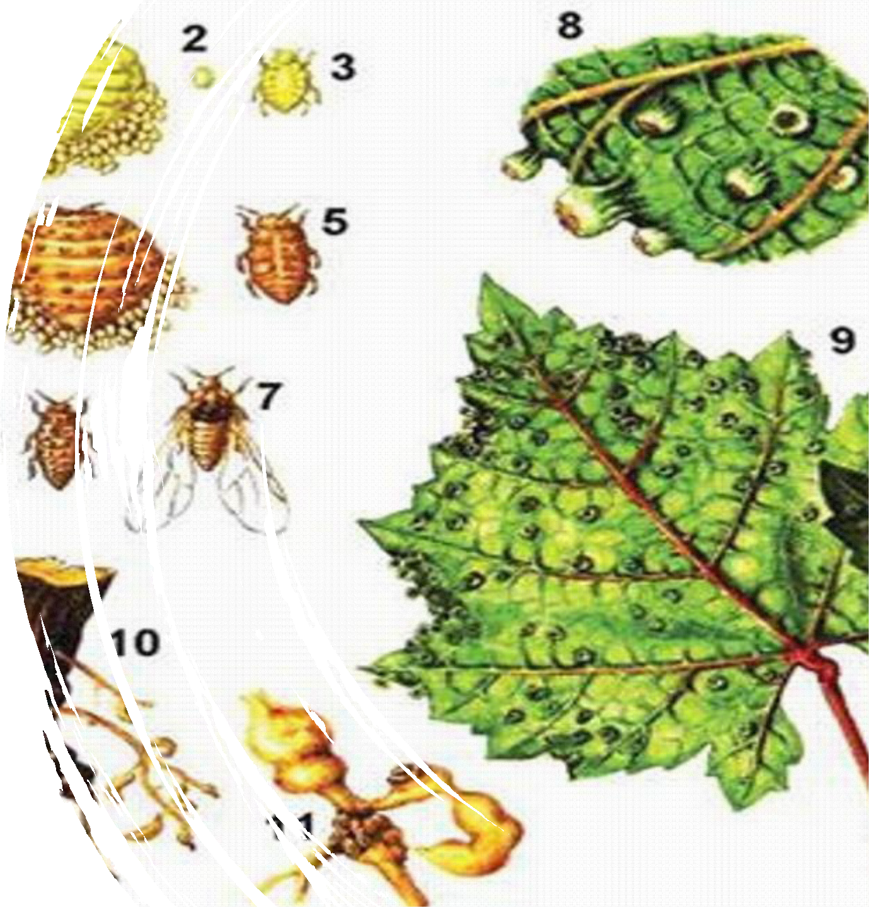
о
Pests in vineyards
Phylloxera
The grape phylloxera - Viteus vitifolliae is an aphid of American origin. It was transferred to Europe in 1863, and to Bulgaria in 1884. In less than 30 years, it has destroyed tens of millions of acres of vineyards grown on own roots. The enemy spared only the vineyards, grown on strong sandy soils.
2700 Blagoevgrad
“Stefan Stambolov” str. №1, fl. 2 tel. +359 896 04 09 03 /+ 359 876 71 24 09
e-mail: pdbulgaria2010@gmail.com

Slide 19
Pests in vineyards
Phylloxera
The Grape Phylloxera damages the leaves and roots, as there are no visible disorders in the root system of the vine, due to the presence of acidic ingredients in the juices, inactivating the enzymes released by the aphid when sucking the juice. Characteristic of the European Phylloxera is that it destroys only the roots of the vines, destroying them completely and depriving the plants of water and mineral salts, as a result of which, they dry out.
Prevention : The fight against the enemy includes monitoring of the phenology, agro-technical measures, preparations and selection of a terrain for planting vines, cleared of previous species. Phylloxera can retain its vitality for up to 7-8 years after removing the vines
2700 Blagoevgrad
“Stefan Stambolov” str. №1, fl. 2 tel. +359 896 04 09 03 /+ 359 876 71 24 09
e-mail: pdbulgaria2010@gmail.com

Slide 20
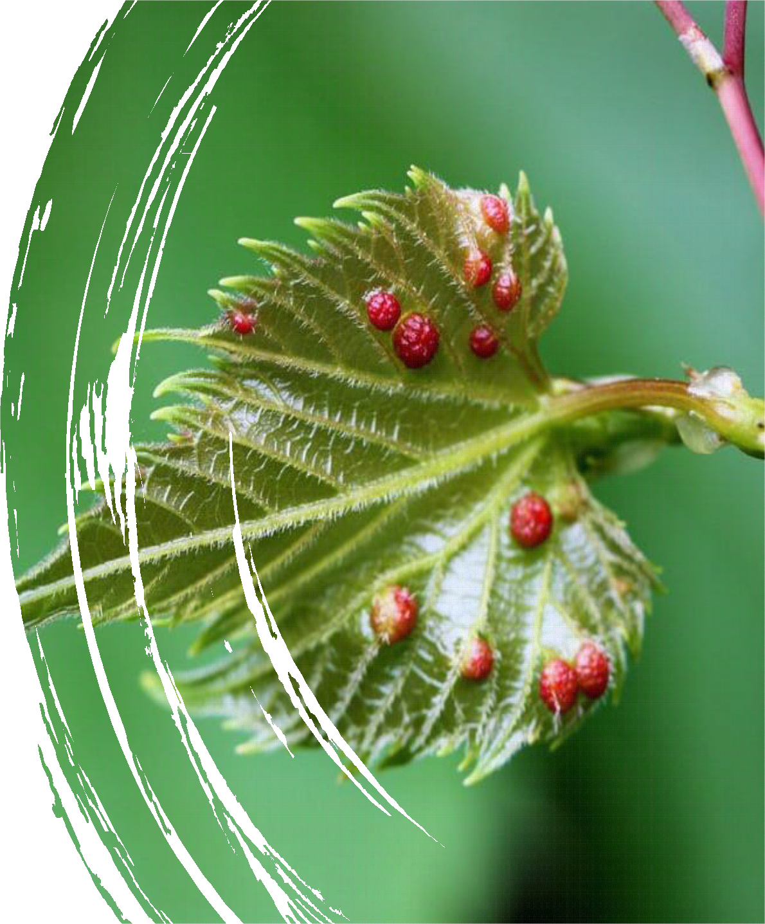
Pests in vineyards
Phylloxera
Insects assimilate reproductive genes from VITIS VINIFERA to create their own living space on the plant.
Scientists at the University of Toledo, Spain, used the RNA sequence to quantify the transcriptional responses of wild vine (Vitis riparia )leaves to the bile parasite, phylloxera. Research has shown that the insect that causes grape phylloxera disease traps the reproductive RNA of a grapevine to create a leaf bile / lump. The lump is a small-sized formation on the leaves of the vine that resembles a wart, flower or fruit and provides insects with a safe place to maintain and reproduce. Subsequently, phylloxera uses it as a place to extract nutrients from the vine.
2700 Blagoevgrad
“Stefan Stambolov” str. №1, fl. 2 tel. +359 896 04 09 03 /+ 359 876 71 24 09
e-mail: pdbulgaria2010@gmail.com

Slide 21
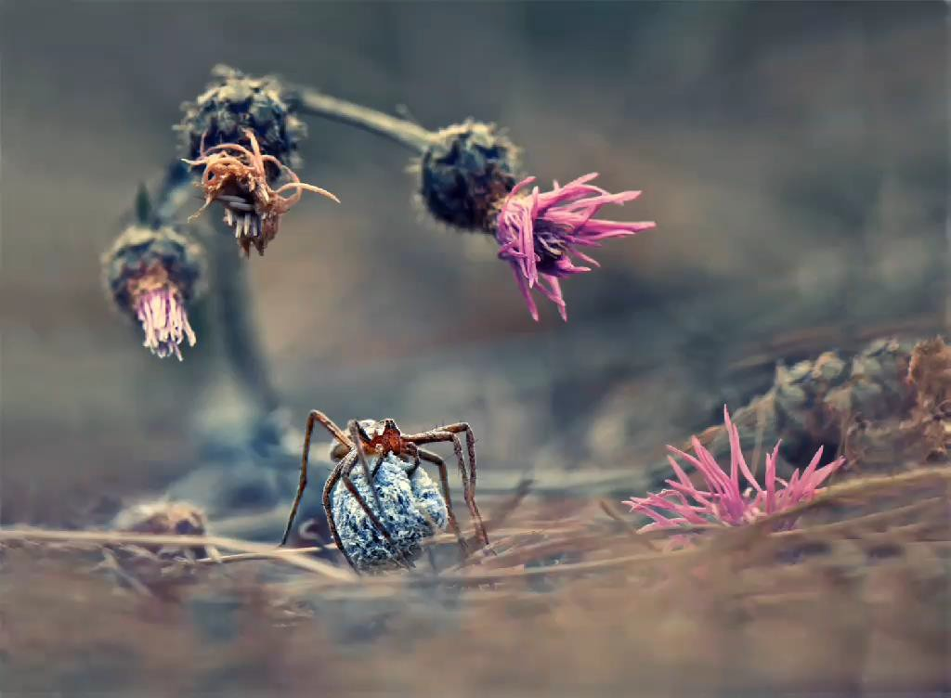
Pests in vineyards
Spider Mite
2700 Blagoevgrad
“Stefan Stambolov” str. №1, fl. 2 tel. +359 896 04 09 03 /+ 359 876 71 24 09
e-mail: pdbulgaria2010@gmail.com

Slide 22
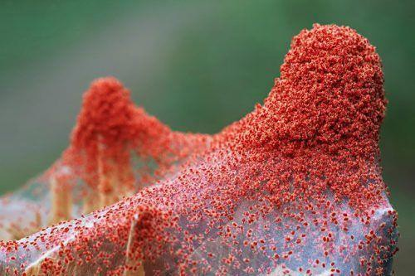
Pests in vineyards
Spider Mite
When the spider mite is found on the leaf tissue, the pest leaves "saliva", which causes painful damage to the plant, causes improper cell division and disruption of vital processes. As a result of vital activity and nutrition, spinal fibers are formed, in which it forms its colonies.
The appearance of ticks on the grapes is accompanied by damage to the leaves, which become yellow or red, depending on the variety The leaves are covered with spots of red, silver and pale yellow color. White spots form on the shady (below) side. The next stage is the coating of the leaves with a characteristic tobacco coating, they begin to twist, dry out and fall off.
2700 Blagoevgrad
“Stefan Stambolov” str. №1, fl. 2 tel. +359 896 04 09 03 /+ 359 876 71 24 09
e-mail: pdbulgaria2010@gmail.com

Slide 23
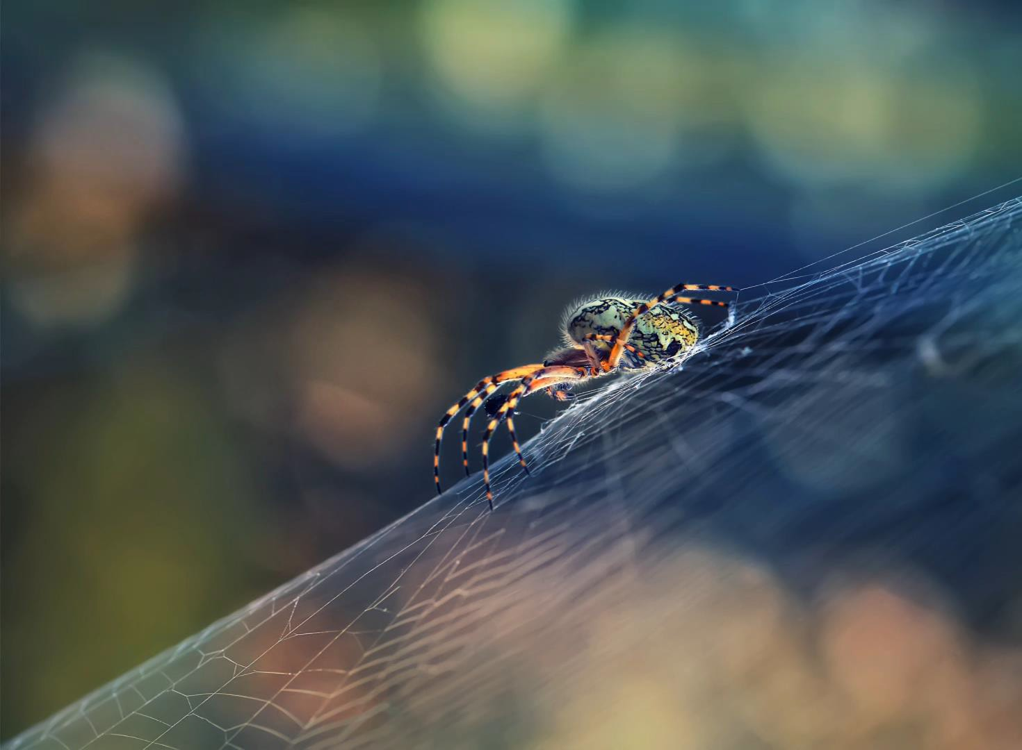
Pests in vineyards
Spider Mite
2700 Blagoevgrad
“Stefan Stambolov” str. №1, fl. 2 tel. +359 896 04 09 03 /+ 359 876 71 24 09
e-mail: pdbulgaria2010@gmail.com

Slide 24
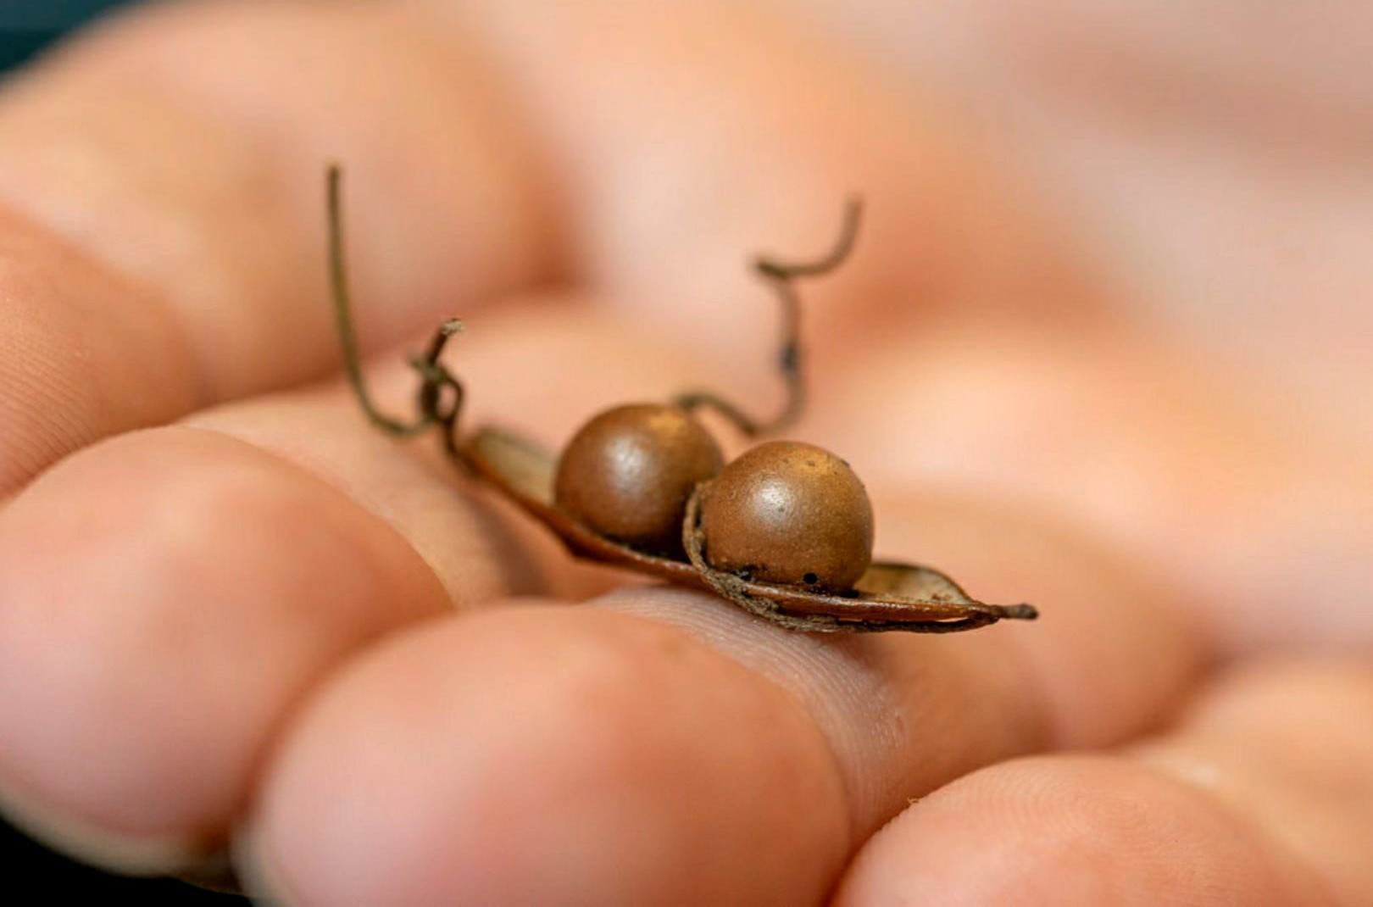
Pests in vineyards
Association Prosperity and Development in Bulgaria Project:“SOS for endangered traditional vine varieties” Acronym: “VineSOS”
Project No. 1829
2700 Blagoevgrad
“Stefan Stambolov” str. №1, fl. 2
tel. +359 896 04 09 03 /+ 359 876 71 24 09
e-mail: pdbulgaria2010@gmail.com

Slide 25
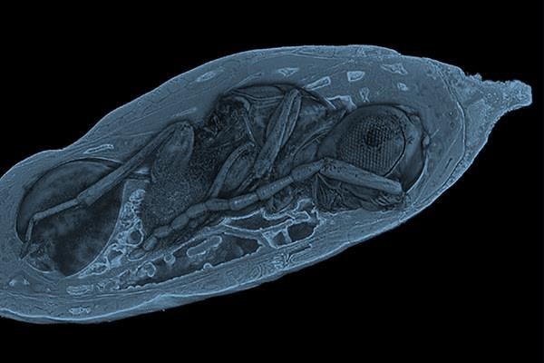

Pests in vineyards
Association Prosperity and Development in Bulgaria Project:“SOS for endangered traditional vine varieties” Acronym: “VineSOS”
Project No. 1829
2700 Blagoevgrad
“Stefan Stambolov” str. №1, fl. 2
tel. +359 896 04 09 03 /+ 359 876 71 24 09
e-mail: pdbulgaria2010@gmail.com

Slide 26
Pests in vineyards
Wasps
Wasps feed on the flesh part and grape juices. Sometimes they are so numerous that they pose a danger to production. Unlike bees, wasps gnaw on the skin of grapes and thus gain access to the inside.
Wasp control is a very difficult task for every farmer, as there are no insecticides to adequately fight this type of pests.
Nest destruction often remains one of the most effective methods, but implementation is difficult. It should be done in the evening in the dark with a protective suit and the area should be treated after the procedure.
Trapping sweet liquids in bottles is an ingenious way to catch wasps, but when their population is large it is not effective.
Spraying with a setting of hot peppers, wormwood, tobacco or tansy helps repel wasps, but should be applied every 5 days, which is time consuming.
Association Prosperity and Development in Bulgaria Project:“SOS for endangered traditional vine varieties” Acronym: “VineSOS”
Project No. 1829
2700 Blagoevgrad
“Stefan Stambolov” str. №1, fl. 2
tel. +359 896 04 09 03 /+ 359 876 71 24 09
e-mail: pdbulgaria2010@gmail.com

Slide 27
Pests in vineyards
Association Prosperity and Development in Bulgaria Project:“SOS for endangered traditional vine varieties” Acronym: “VineSOS”
Project No. 1829
2700 Blagoevgrad
“Stefan Stambolov” str. №1, fl. 2
tel. +359 896 04 09 03 /+ 359 876 71 24 09
e-mail: pdbulgaria2010@gmail.com

Slide 28
Pests in vineyards
Wasps
Association Prosperity and Development in Bulgaria Project:“SOS for endangered traditional vine varieties” Acronym: “VineSOS”
Project No. 1829
2700 Blagoevgrad
“Stefan Stambolov” str. №1, fl. 2
tel. +359 896 04 09 03 /+ 359 876 71 24 09
e-mail: pdbulgaria2010@gmail.com

Slide 29
THANK YOU FOR YOUR ATTENTION
Association Prosperity and Development in Bulgaria Project:“SOS for endangered traditional vine varieties” Acronym: “VineSOS”
Project No. 1829
2700 Blagoevgrad
“Stefan Stambolov” str. №1, fl. 2
tel. +359 896 04 09 03 /+ 359 876 71 24 09
e-mail: pdbulgaria2010@gmail.com

